Slide 1

PIC…
Everything but Errors
Mary Hirsch-Justice
Housing Data Systems maryh@housingdatasystems.com
September 15, 2022

Slide 2
Agenda
Monthly PIC Review
- Public Housing Reports
- Voucher Reports

Slide 3

Monthly Review
Delinquency Report (PH & VO)
Reexam Report (PH & VO)
HQS Reports (VO)
SEMAP (VO)
Invalid Tenant ID Report (PH & VO)
Possible Duplicates Report (PH & VO)
Portability Billing (VO)
MTCS VO Iss/Exp (VO – EHV)
MTCS Adhoc (PH & VO)

Slide 4
Delinquency Report - PH
Form 50058→Reports
Updates Monthly
Sourced from PIC Reexam Report
50058 Required
- Total household count
on PH Reexam Report
50058 Received
- Total households where last
Reexam date is earlier than 14
months (<=13 months)

Slide 5
Delinquency Report - PH
Delinquency Report
As of August 31 2022
Level Of Information |  | Field Office
Effective Start Date |  | May 01 2021 |  | Effective End Date |  | August 31 2022
Field Office/s: | 5FPH:MICHIGAN STATE OFFICE
HA Code | HA Name | HA FYE | Program | ACC Units | VMS Units Leased | As of (MM/YY) | Port Outs | Port ins | 50058 Required | 50058 Received | Difference | Reporting Rate
MI051 | Lincoln Park HC | 31-Mar | PH | 120 |  |  |  |  | 110 | 108 | 2 | 98.18

Slide 6
Delinquency Report - VO
Report updates monthly
Reporting Rate will normally be greater than 100% if PHA reports a net increase in vouchers to PIC.
Reporting Rate will normally be less than 100% if PHA reports a net decrease in vouchers to PIC.
Understand each data element.

Slide 7
Delinquency Report-VO
VMS Last Day Count
- 30 – 60 day timing difference
between VMS and PIC.
Portability Move-out
- Sourced from PIC as of
Summarization Report End Date.
Portability Move-in
- Sourced from PIC as of
Summarization Report End Date

Slide 8
Delinquency Report-VO
50058 Required Count
+ VMS Last Day Count
- Portability Move-out Count
+ Portability Move-in Count
50058 Received
- Total active households where
last effective date is less than 16
months from Report End Date.

Slide 9
Delinquency Report-VO
Minimum 95% Reporting Rate required to be scored for SEMAP Indicators 9, 10, 11, 12, and 14.
- Do NOT overstate Last Day of
Month count reported to VMS
especially if a small PHA and
11th month of fiscal year…

Slide 10
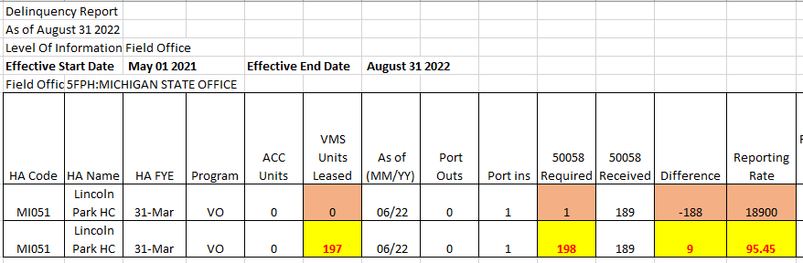
Delinquency Report - VO
Notes:
08.31.2022 Summarization FAILED!!

Slide 11
Reexam Report
Form 50058→Reports
Updates Monthly
Sources data from ‘Current database’ or ‘Historical database’ if the last effective date is ‘FUTURE’ from the Report End Date. Does not include future New Admissions.
Report order: Oldest to newest
Current: 11 months and less
Notes:
Change in HOH SSN with future effective date causes problems.
Feeder for SEMAP Indicator 9
Includes Action 9 – Annual Reexam Searching.

Slide 12
Reexam Business Rules
Based on Effective Date if last Action Code: 1 – New Admission
2 – Annual Reexam
12 – Flat Rent Annual Update
Based on Projected Next AR date minus 12 Months if last Action Code:
3 – Interim Reexam
4 – Portability Move-In
7 – Other change of Unit
9 – Annual Reexam Searching
14 – Historical Adjustment

Slide 13
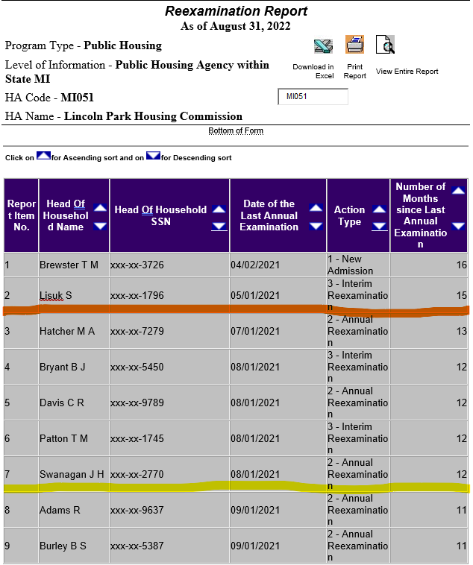
Reexam Report-PH
Notes:
08.31.2022 Summarization did NOT fail for PH... But it did for VO Program
2 records 14 months or older that were not counted on Delinquency Report.
Total 7 records older than 11 months.

Slide 14
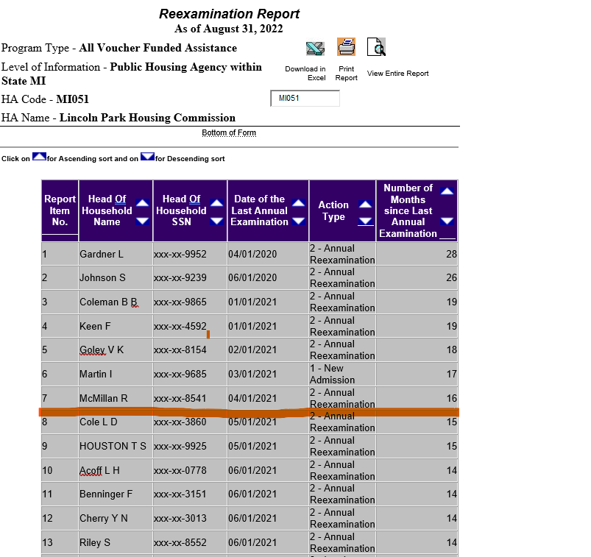
Reexam Report-VO
Notes:
08.31.2022 Summarization FAILED for VO Program
Review records 16 months and older for not being counted on Delinquency Report.
Feeder Report for SEMAP Indicator 9: Any record 14 month and older is out of compliance.

Slide 15
Pre-contract HQS Report
Updates Monthly
Feeder for SEMAP Indicator 11.
Sources data from PIC’s current database or ‘Historical db’ if effective date is future from Report End Date.
Includes Actions 1, 2/3 when 12c=Y,
4, and 7.

Slide 16
Pre-contract HQS
Last Passing HQS Inspection Date must be on or before the effective date of the move action.
- Actions 1, 2/3 if 12b = Y, 4, and 7.
Cannot correct Passing HQS Inspection Date on Action 13.
Notes:
If Action 1, 4, 7, or 2/3 if 12b = Y

Slide 17
Continuing HQS Report
Updates Monthly
Feeder for SEMAP Indicator 12.
Sources data from PIC’s current database or historical db if effective date is future from the Report End Date.
Does not include Action 9 – Annual Reexam Searching or Project Based VO.

Slide 18
Continuing HQS Report
Last HQS Inspection considered overdue if 26 months or older from Summarization Report End Date.
Use Action 13 to update PIC and user must determine appropriate Effective Date.
Cannot correct Last HQS date, for SEMAP, on a 50058 with a future effective date from the Report End Date or SEMAP date.

Slide 19
SEMAP Indicator Report
Updates Monthly
At FYE, report is used to score SEMAP Indicators 9, 10, 11, 12, and 14.
Sources data from Reexam, Pre-contract HQS, Annual HQS, and FSS Reports.
Monthly, use Report Tab 1 to manage Indicators 10, 11, and 14.
Notes:
Does not include

Slide 20
SEMAP Indicator Report
Tab 2 – Most Recent “Completed” SEMAP Indicator Report
    Good Historical Record
Notes:
Does not include

Slide 21
Invalid Tenant ID Report
Form 50058→ Tenant ID Management→ Reports→ Invalid Tenant ID Report
Identifies household members with invalid SSN, Last Name, DOB, Deceased, or Invalid AID.
Review report monthly and submit appropriate corrections to PIC via Form 50058.
Notes:
Must mark 50058 as a correction using reason code
2 Family correction non-income OR
4 PHA correction non-income

Slide 22
Possible Duplicates Report
Form 50058→ Tenant ID Management→ Reports→ Possible Duplicate Tenant Report
Identifies household members that appear in more than one household.
Losing Agency or Program must correct PIC.
Review the report monthly and take appropriate action.
Notes:
Must mark 50058 as a correction using reason code
2 Family correction non-income OR
4 PHA correction non-income

Slide 23
Portability Billing Reports
Form 50058→ Viewer→ Reports→ Portability Billing Report
PHA Billing Report
- Lists tenants and PHA being billed
PHA Billed Report
- Lists tenants and PHA billing you
Review the report monthly and take appropriate action.
Data feeds Delinquency Report
Notes:
PHA Billing Report: Should never be greater than number of vouchers administered.
PHA Billed Report: Should never be less than the number of vouchers PHA is being billed for!

Slide 24
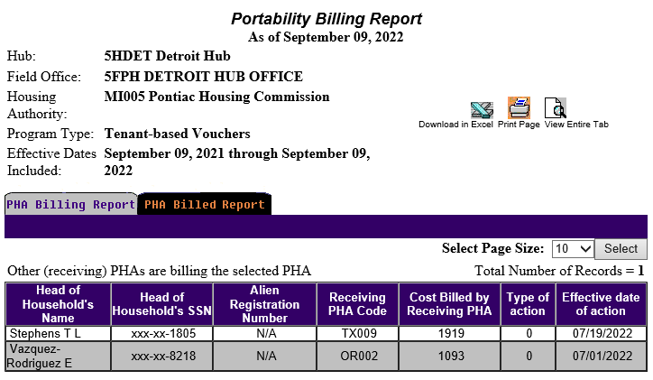
Portability Billing Reports
Notes:
08.31.2022 Summarization FAILED for VO Program
Review records 16 months and older for not being counted on Delinquency Report.
Feeder Report for SEMAP Indicator 9: Any record 14 month and older is out of compliance.

Slide 25
Issue & Expired VO Report
Form 50058→ Viewer→ Reports→ MTCS VO Iss/Exp Report
Updates Real-time.
Useful for tracking issuance of Other Special VO types such as EHV.
Notes:
Sources from Unit Status Detail Report.
Use to reconcile to the early versions of Operating Subsidy Tool.

Slide 26
Ad Hoc Report
PIC Main→ ADHOC→ Form 50058 Ad hoc Report
Updates Real-time.
Useful as a historical record and used to reconcile to Monthly Summarization Reports.

Slide 27
Unit Status Summary Report-PH
Housing Inventory→ Development→ Reports→ Unit Reports→ Report Type→ Status Changes Summary
Updates Real-time and retroactive.
Displays unit counts by first or last day of month by Unit Status Type.
Notes:
Sources from Unit Status Detail Report.
Use to reconcile to the early versions of Operating Subsidy Tool.

Slide 28
Unit Status Summary Report-PH
PIC lacks appropriate Business Rule:
- Unit is considered VACANT as of
the effective date of Action 6 – EOP.
Select appropriate date range
- Fiscal year to date
- 07/01/XX – 06/30/XX for OP Sub
Download report to Excel.
- Verify total unit month count to
ACC unit count.
Notes:
Business Rules for PIC – Unit Status Summary Report.
Unit Considered VACANT as of the effective date of Action 6 - EOP
Business Rules for LAST VERSION of Operating Subsidy TOOL.
Unit considered OCCUPIED thru the effective date of Action 6 – EOP.

Slide 29
Vacant Unit Report
Housing Inventory→ Development→ Reports→Occ/Aging Reports→Aging
Updates in Real-time.
Counts days from Unit Status Change Effective Date to Current Date.
Unit list includes Vacant Dwelling, Non-dwelling, and Vacant HUD Approved units.

Slide 30
PIC…
Everything but Errors
Questions???

Slide 31

Thank You !!!
Mary Hirsch-Justice
Housing Data Systems maryh@housingdatasystems.com
Housing Data Systems
PO Box 883
West Salem, WI 54669
(608) 786-2366

Slide 32
Unit Status and Occupancy
Notes:
Operating Subsidy sourced from PIC
PHAS – MASS sourced from FASS
PHAS – CAP Fund sourced from PIC

Slide 33
Unit Status and Occupancy
PIH Notice 2021-35
Unit Tenant Status Types
- Occupied
- Vacant HUD Approved
- Non-dwelling
Reporting
- Operating Subsidy
- Capital Funding
- PHAS – MASS
- PHAS – CAP

Slide 34
Occupied Unit Status
Field Office WRITTEN Approval required:
- Occupied by Employee
- Occupied by Police Officer
- Occupied by Over Income
- Occupied Unauthorized

Slide 35
Occupied Unit Status
Eligible for OP Subsidy
- Occupied by Assisted Tenant
Not Eligible for OP Subsidy
- Occupied by Employee
- Occupied by Police Officer
- Occupied by Over Income
- Occupied Unauthorized

Slide 36
Occupied Unit Status
The following Occupied Status Types are included in both the OCCUPIED and AVAILABLE Unit Counts for reporting Occupancy to FASS, PHAS MASS, PHAS CAPFund, and FO.
- Assisted Tenant
- Employee
- Police Officer
- Over Income

Slide 37
Occupied Unit Status
Occupied – Unauthorized for reporting Occupancy to FASS, PHAS MASS, PHAS CAPFund, and FO:
- Excluded from OCCUPIED unit
counts
- Included in AVAILABLE unit
counts

Slide 38
Vacant HUD Approved
Field Office WRITTEN & PIC Approval required:
- Undergoing Modernization
- Court Litigation
- Natural Disaster
- Casualty Loss
- Market Conditions

Slide 39
Vacant HUD Approved
All Vacant HUD Approved units are ELIGIBLE to receive:
- Operating Subsidy
- Capital Funding

Slide 40
Vacant HUD Approved
PHAS MASS - Occupancy
- All units EXCLUDED from the
Numerator UML and
Denominator UMA
PHAS CAP Fund – Occupancy
- All units EXCLUDED from
Numerator UML
- All Units INCLUDED in
Denominator UMA
Notes:
Action Plan
- Undergoing Modernization: Plan to work on units early in FY so units can be reoccupied by FYE.

Slide 41
Non-dwelling Unit Status
Field Office WRITTEN & PIC Approval required:
- Administrative
- Resident Amenities
- Moving to Work
- Unauthorized
- Special Use: Anti-Drug Crime
- Special Use: Self-Sufficiency
- Special Use: Other Resident
Activities

Slide 42
Non-dwelling Unit Status
NOT Eligible for Operating Subsidy BUT are eligible for Capital Funding:
- Administrative
- Resident Amenities
- Moving to Work
- Unauthorized

Slide 43
Non-dwelling Unit Status
Eligible for Operating Subsidy AND Capital Funding:
- Special Use: Anti-Drug Crime
- Special Use: Self-Sufficiency
- Special Use: Other Resident
Activities

Slide 44
Non-dwelling Unit Status
(Non-Special Use)
PHAS MASS – Occupancy
- EXCLUDED from Numerator UML
- INCLUDED in Denominator UML
PHAS CAP Fund - Occupancy
- EXCLUDED from Numerator UML
- INCLUDED in Denominator UML

Slide 45
Non-dwelling
SPECIAL USE Unit Status
PHAS MASS – Occupancy
- Excluded from Numerator UML
and Denominator UML
PHAS CAP Fund - Occupancy
- Included in both Numerator UML
and Denominator UML

Slide 46
Demo-Dispo
Approved and Vacant
PHAS MASS – Occupancy
- EXCLUDED from Numerator UML
and Denominator UML
PHAS CAP Fund - Occupancy
- EXCLUDED from Numerator UML
and Denominator UML

Slide 47
Vacant/Vacant
PHAS MASS – Occupancy
- EXCLUDED from Numerator UML
- INCLUDED in Denominator UML
PHAS CAP Fund - Occupancy
- EXCLUDED from Numerator UML
- INCLUDED in Denominator UML
Notes:
OPERATING Subsidy Submission: Column B Line 14 – Limited Vacancies (24 CFR 990.150)
PHAs with over 100 units should enter the lesser of 3% of Line 15 – Total Unit Months of Column A or Line 11 – Units Vacant and not categorized above of Column A.
PHAs with 100 or fewer units should enter the lesser of 60 unit months or Line 11 of Column A

Slide 48
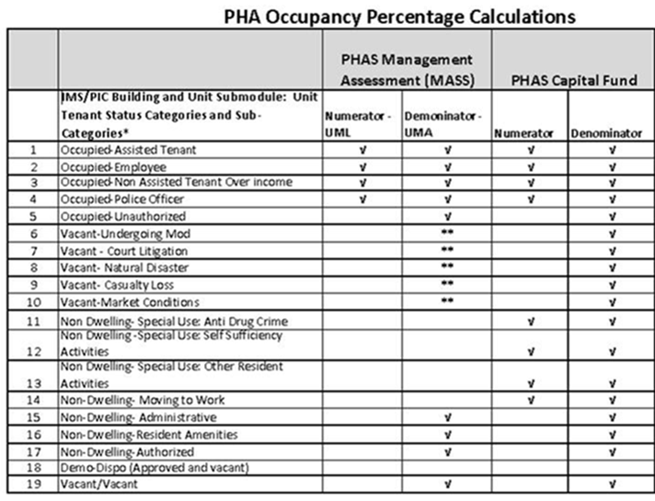
Notes:
* See PIH Notice 2011-07, Guidance on IMS/PIC Development sub-module reporting and validation on the use of public housing units and unit reporting in IMS/PIC.
** In accordance with the PHAS Interim Rule (24CR Part 902) these units are excluded when approved by HUD.
PHAS MASS: PHA fiscal year unit months leased (FDS Line 11210) over units months available (FDS Line 11190).
FIRST or LAST day depending up Operating Subsidy submission for the FY
12 months of data
HUD Agency Priority Goal (APG) from PIC for the entire portfolio of PHAS as the date captured/reported. Uses same as PHAS Capital Fund – Occupancy.
LAST Day of Month, sourced from PIC on LAST day of FY
ONE month look

Slide 49
Status and Occupancy
Questions???

Slide 50
Data Deadlines
Notes:
Operating Subsidy sourced from PIC
PHAS – MASS sourced from FASS
PHAS – CAP Fund sourced from PIC

Slide 51
HUD FO Review
Monthly
- Delinquency Report
- HUD HQ calculates Occupancy
on the last day of each month
‘as of’ last day of month.
(Management Tool Only)
Quarter End/FYE
- Delinquency Report
- Overdue Reexam
Notes:
HUD FO contacts any PHA with vacancy = or > than 7%.
FYE count is used to calculate PHAS CAPFund Occupancy Rate.
May also review EIV Deceased Member Report, Multiple Subsidy

Slide 52
FASS - Occupancy
Monthly and Year-to-Date Occupancy reported on PHA financials:
- FDS 11210 Unit Months Leased
- FDS 11190 Unit Months Available
Data is not currently sourced from PIC but should be supported by HUD Form 50058.
FIRST or LAST day based on OP Fund submission for that FYE.
Notes:
Suggest booking the YTD number on the financials and forcing the MO number rather than booking the MO number.
Financial Data Schedule Line Definition Guide May 2012
11190 Unit months available
This FDS line represents the number of months available for all Low Rent, Section 8, other subsidized and non-subsidized programs with unit month counts.
For Public Housing projects the PHA is to report the total number of months each ACC unit was under ACC in the PHA’s fiscal year reduced by the number of months each ACC unit was in the following categories during the fiscal year:
Vacant – Undergoing Modernization
Vacant – Court Litigation
Vacant – Natural Disaster
Vacant – Casualty Loss
Vacant – Market Conditions
Non-Dwelling - Special Use: Anti-Drug/Crime
Non-Dwelling - Special Use: Self Sufficiency Activities
Non-Dwelling - Special Use: Other Resident Activities
Non-Dwelling - Special Use: Other Moving to Work (applies only for an MTW PHA)
Units Approved by HUD for Demolition/Disposition
PHAs may reduce their unit months available for these categories only if HUD approved the vacancy, special use or demolition/disposition application.
11210 Unit months leased
This FDS line represents the total number of dwelling unit months under lease by tenants and program participants during the reporting period. The reported amount should be supported by the PHA’s tenant rent rolls or housing assistance payment records.
For Public Housing projects the number of months reported must be on the same basis (first day of the month or the last day of the month) the PHA used when reporting units leased on the Form HUD-52723 – Calculation of Operating Subsidy. Units leased include only those units categorized in PIC as occupied by low income families (assisted tenants), police officers, and non-assisted tenants over income.
For the HCV program, the PHAs vouchers leased should be based on the first of the month.

Slide 53
PHAS - Occupancy
Based on PHA’s FY
MASS (16 points)
- 12 month count
- Sourced from FASS
- Count based on either FIRST or
LAST day of month (OP Sub).
CAPFund (5 points)
- 1 month count
- Sourced from PIC last day of FY
- Count based on LAST day of
month

Slide 54
CAP Fund Certification
Data Drivers as of 06.30:
- Unit CAP Fund Indicator = Y
- Unit ACC Indicator = Y
- Unit Designation
- Bedroom count
Occupancy status is NOT an issue
Clean-up Demo-Dispo units
Effective Date of Change is critical
Usually completed during Jul-Aug
Notes:
CAP Fund Indicator must be = YES
Effective Date of Change is critical not only to CAP Fund Reporting… but it also impacts OP Fund, FASS, and PHAS reporting. Don’t focus exclusively on meeting the 06.30 reporting deadline! Therefore it is important to consider the impact on ALL ‘open’ reporting that can be impacted by the effective date of the Unit Status or Indicator change.
Standing Units count includes Dwelling and Non-dwelling units (ACC=Y).
Does NOT include MERGED
Does NOT include Non-ACC Units
Removed Units
Does NOT include MERGED unless the Mother Unit is removed from inventory.
Non-ACC Units
Are listed under Unit Detail and Development Profile
Unit Designation
Includes Dwelling and Non-dwelling Unit Designations
General Occupancy
Mixed Elderly and Disabled not HUD officially designated
Officially Elderly
Officially Disabled
Officially Mixed Elderly and Disabled
Does NOT include MERGED Units with ACC, CAPFund, OPFund = NO

Slide 55
Operating Subsidy Submission
Reporting period: 07.01 to 06.30
Data sourced from PIC for 12 month period:
- Unit ACC Indicator Status
- Unit OP Fund Indicator Status
- Unit Tenant Status Types
- Occupancy
Each year the PHA can select counts for 12 month period as either FIRST or LAST day of month.
PIC lacks EOP Business Rule
Notes:
Business Rules for PIC – Unit Status Summary Report.
Unit Considered VACANT as of the effective date of Action 6 - EOP
Business Rules for LAST VERSION of Operating Subsidy TOOL.
Unit considered OCCUPIED thru the effective date of Action 6 – EOP.

Slide 56
Data Deadlines
Questions???

Slide 57

What’s Up?
Notes:
Operating Subsidy sourced from PIC
PHAS – MASS sourced from FASS
PHAS – CAP Fund sourced from PIC

Slide 58
Flat Rent
Annual analysis/update
Annual Rent Option
Ceiling Rents

Slide 59
Flat Rent – Annual Analysis
Determine if current flat rent is at lease 80% of the new FMR
Update the flat rent amounts if required to meet the minimum 80% requirement within a reasonable time but no later than 90 days of HUD publishing new FMRs.
  Suggest 1st of January each year.
Notes:
FLAT RENT POLICIES – HOW TO COMPLY ON AN ANNUAL BASIS
In order to comply with the flat rent requirements annually, PHAs must: 4
1) Calculate flat rents using a rent reasonableness methodology,1 as defined in 24 CFR Part 960.253(b), for determining the flat rent based on the market rent of comparable units in the private, unassisted rental market. Such a reasonable method should consider the location, quality, size, unit type, unit age, and any amenities;
2) If the flat rent, as determined by the rent reasonableness study, is at least 80 percent of the FMR, PHAs must set flat rents at the amount determined by the rent reasonableness study;
3) If the flat rent, as determined by the rent reasonableness study, is less than 80 percent of the FMR, PHAs must set flat rents at no less than 80 percent of the FMR, subject to the utilities adjustment in section 3 of this notice;
4) If the FMR falls from the previous year, PHAs, may, but are not required to lower the flat rent amount to 80 percent of the FMR;
5) Include a description of flat rent policies in the PHA annual plan or in documents available for a public hearing as applicable;
6) Update the flat rent policies in the Admissions and Continued Occupancy Policies (ACOP) as necessary;
7) At all new admissions, permit the family to choose between the flat rent amount and the income-based rent;
8) For families that are already paying the flat rent amount, PHAs must offer any changes to flat rent amount at the next annual rent option, and permit the family to choose between the flat rent amount and the income-based rent, subject to the requirements of Section 6 of this notice; and
9) Upon issuance of new FMRs by HUD, the PHA must:
• Determine if the current flat rent is at least 80% of the new FMR;
• Update the flat rent amounts2 if necessary to meet the 80% requirement within a reasonable time but no later than 90 days of HUD publishing new FMRs;
• Apply the new flat rents to all new admissions and to existing families at the next annual rent option, subject to Section 6 of this notice.
. FLAT RENT POLICIES – HOW TO COMPLY WITH THE NEW REQUIREMENTS IN THE INITIAL YEAR
In order to comply with the statutory requirements, PHAs must do the following:
1) Compare the current flat rent amount as determined by the PHA to the applicable FMR;
2) If the existing flat rent amount is at least 80 percent of the FMR, the PHA is in compliance with the law, and no further steps are necessary;
3) If the existing flat rent amount is less than 80 percent of FMR, PHAs must revise their flat rents to no less than 80 percent of FMR, subject to the utilities adjustment in section 3 of this notice;
4) If changes to flat rents are necessary, include a description of the changes to the flat rent policies in a significant amendment to the PHA Annual Plan. Section 8 of this notice provides for a streamlined process for completing this requirement;
5) Update the flat rent policies in the Admissions and Continued Occupancy Policies (ACOP);
6) The PHA must offer the new flat rent and the applicable income-based rent to all new admissions to the program within 90 days of formally adopting the new flat rents, but not later than October 31, 2014; and
7) Within 90 days after a PHA has formally adopted the new flat rents, but not later than October 31, 2014, the PHA must begin to offer the new flat rent to families that are currently paying the flat rent amount, at the family’s next annual rent option, and permit the family to choose between the flat rent amount and the income-based rent, subject to the requirements of Section 6 of this notice.

Slide 60
Flat Rent – Annual Analysis
Apply the new flat rents to all new admissions and to existing families at their next annual rent option.
If FMR increases, PHA may need to increase the flat rent to the minimum 80% of FMR.
If FMR decreases from previous year, PHAs may, but are not required to, lower the flat rent to 80% of FMR.

Slide 61
Annual Rent Options
PHAs are required annually to give families the option to choose between paying the flat rent or the income-based rent, AND PHAs may NOT give families the option more than once per year, except in the case of financial hardship.
(24 CFR 960.253(a)

Slide 62
Annual Rent Options
PHAs must provide:
  PHA’s policies on switching the type of rent due to financial hardship.
  The dollar amount of the flat rent and the income-based rent.
Notes:
In order for PHAs to comply with the requirements to conduct an annual rent option, and to provide families with sufficient information to make an informed choice, PHAs must do the following:
At initial occupancy, or in any year where a current program participating family is paying the income-based rent:
1) Conduct a full examination of family income and composition at the first annual rent option (Year 1);
2) Inform the family of the flat rent amount and the rent amount determined by the examination of family income and composition;
3) Inform the family of the PHA’s policies on switching rent types due to financial hardship; and
4) Apply the family’s rent decision at the next lease renewal.
At the second and third annual rent options for families that choose to pay the flat rent:
1) PHAs may, but are not required to conduct a full examination of family income and composition for the second and third annual rent options. If a PHA chooses not to conduct an examination of family income for these annual rent options, PHAs must use the income information from the examination of family income and composition from the first annual rent option;
2) PHAs must inform the family of the updated flat rent amount, and the rent amount determined by the most recent examination of family income and composition;
7. CONDUCTING ANNUAL RENT OPTIONS
24 CFR 960.253(a) requires PHAs to annually give families the option to choose between paying the flat rent or the income-based rent, and stipulates that PHAs may not give families the option more than once per year, except in the case that the family has chosen the flat rent and experiences a financial hardship. 24 CFR 960.253(e) stipulates that in order for a family to make an informed choice regarding rent options, PHAs must provide at least the following information: 7
• The PHA’s policies on switching the type of rent due to financial hardship;
• The dollar amount of the flat rent and the income-based rent.
24 CFR 960.253(e)(2) permits PHAs the flexibility to conduct reexaminations of family income once every three years instead of annually for families that choose to pay the flat rent. In years when a PHA does not conduct a full reexamination of family income, PHAs must give the family the option of paying the flat rent or the income-based rent as calculated from the most recent examination of family income and composition.
In order for PHAs to comply with the requirements to conduct an annual rent option, and 3) PHAs must inform the family of the PHA’s policies on switching rent types due to financial hardship; and
4) PHAs must apply the family’s rent decision at the next lease renewal.
For the purpose of conducting the rent option meeting for a family that has paid the
flat rent for the previous three years, and for which the PHA has not conducted a
reexamination of family income and composition in the last three years, the PHA must
complete a full reexamination of family income and composition in order to update the
income-based rent amount.
PHAs are reminded that the flat rent amount a family pays is not locked in for the three year period. Instead, the PHA must revise the flat rent amount from year to year based on the findings of the PHA’s rent reasonableness analysis and changes to the FMR.

Slide 63
HOTMA PH Over-Income 103
PIH Notice 2019-11
Must update ACOP and possible Significant Amendment to PHA’s Annual Plan.
Going forward, must continue to update over-income limits in PHA ACOP no later than 60 days after HUD publishes new income limits each year.
Annual or Interim reexam starts the 2-year clock. PHA must provide written notification to family if one-year after the initial over-income finding the family’s income continues to exceed over-income limit.
Notes:
Notice PIH 2019-11 Final Implementation PH Over-Income under HOTMA Section 103
Calculate Final over-income (Very Low Income x 2.4) for each family size
After family’s income has exceeded 120% of AMI for 2 consecutive years, a PHA must terminate tenancy within 6 months of second income determination or change family’s monthly rent equal to the greater of

Slide 64
HOTMA PH Over-Income 103
Calculate final over-income (Very Low Income x 2.4) for each family size.
After family’s income has exceeded 120% of AMI for 2 consecutive years, a PHA must terminate tenancy within 6 months of second income determination or change family’s monthly rent to the greater of
(1) Applicable FMR or
(2) Amount of monthly subsidy for the
unit (includes operating and CAPFund)
Notes:
Notice PIH 2019-11 Final Implementation PH Over-Income under HOTMA Section 103
3. Applicability
Section 103 of HOTMA applies to all PHAs operating a public housing program, including Moving to Work (MTW) Agencies, with one exception. Pursuant to section 3(a)(5) of the 1937 Act and 24 CFR 960.503, the over-income limit does not apply to families with income exceeding the over-income limit if they are housed by PHAs operating fewer than 250 public housing units who are renting to over-income families because there are no income-eligible families on the PHA’s waiting list or applying for public housing.
Section 103 requires PHAs to implement the over-income limit. The statutory changes in section 103 of HOTMA do not address the treatment of families whose income exceeds the local low-income limit (80% of AMI), but is below the applicable over-income limit established in HOTMA (50% of AMI multiplied by 2.4). As such, the requirements and flexibilities to be provided through new regulations at 24 CFR 960.261 will be addressed through future rulemaking to establish a uniformed definition of over-income.

Slide 65
HOTMA PH Over-Income 103
Family is no longer subject to this ruling, if PHA discovers thru an annual/interim reexam that a previously over-income family has income below over-income limit.
Notes:
Notice PIH 2019-11 Final Implementation PH Over-Income under HOTMA Section 103
3. Applicability
Section 103 of HOTMA applies to all PHAs operating a public housing program, including Moving to Work (MTW) Agencies, with one exception. Pursuant to section 3(a)(5) of the 1937 Act and 24 CFR 960.503, the over-income limit does not apply to families with income exceeding the over-income limit if they are housed by PHAs operating fewer than 250 public housing units who are renting to over-income families because there are no income-eligible families on the PHA’s waiting list or applying for public housing.
Section 103 requires PHAs to implement the over-income limit. The statutory changes in section 103 of HOTMA do not address the treatment of families whose income exceeds the local low-income limit (80% of AMI), but is below the applicable over-income limit established in HOTMA (50% of AMI multiplied by 2.4). As such, the requirements and flexibilities to be provided through new regulations at 24 CFR 960.261 will be addressed through future rulemaking to establish a uniformed definition of over-income.

Slide 66
Ceiling Rents
HUD is requiring PHAs to reduce ceiling rents to zero without including any guidance in a Federal Regulation or PIH Notice.
If the PHA is correctly reducing the based Flat Rent by a ‘reasonable’ utility allowance, there is no basis for continued use of Ceiling Rents.

Slide 67
What’s Up?
Questions???

Slide 68
Other Topics of Interest
Portability
Voucher Issuance/Expiration
HAP HOLD vs SHOP
Notes:
Removed:
HUD Cost Savings
Biannual HQS Inspections
Pre 07.01.2014
On or after 07.01.2014
SEMAP starting 09.30.2014
Utility Allowance
Based on the lesser of voucher bedroom size or unit size.
Implement at existing family’s next Annual Reexam or Change in Unit after providing 60 day notice.
Implement at Initial Lease-up for vouchers issued on or after 07.01.2014.
NOTE: Utility Allowances
Applicable to HCV programs
The 2014 Act limits the utility allowance (UA) payment for tenant-based vouchers to the unit size for which the voucher is issued,
irrespective of the actual size of the unit rented by the family. HUD specifies that the UA shall be the lower of the UA amount for
the family unit size or the UA amount for the actual unit size rented by the family. Furthermore, if a family is authorized for a 2-
bedroom unit but chooses to lease a 1-bedroom unit, the PHA must provide the UA that corresponds with the 1-bedroom unit. The
only exception is for families with a person with disabilities, where the family requests a higher utility allowance as a reasonable
accommodation needed to make the program accessible to the family member.
This provision applies to current program participants at the family's next annual reexamination. PHAs are reminded of the
requirement to provide at least 60 days' notice. For vouchers issued after July 1, 2014, the new guidelines are effective at initial
lease-up. Families that were issued a voucher prior to July 1, 2014 are subject to prior UA schedules until the family's next annual
reexamination.
PHAs should note that families that opt to remain in a larger unit than their UA affords will incur an increased rental burden as their
subsidy will decrease by the reduced utility allowance.
HUD previously estimated this change would result in $50 million in HAP savings in 2014. Similar to HAP cost-savings generated
by the new ELI definition, PHAs may retain any savings generated in FY 2014 and use them to maintain or increase leasing.
HUD VMS Reviews
Understand the reporting period under review.
Organize your VMS supporting detail.
Organize your financial data.

Slide 69
Portability
Handout
Action Types
- Action 1 or Action 4
= 12e Cost Billed per Month
= 12f PHA Code Billed
- Action 5 or Action 6
- Action 9
Effective Dates?

Slide 70
Portability
PIC Reports
    Portability Billing Report
    Portability Billed Report
    Delinquency Report

Slide 71
Issuance of Voucher
Action 10 – Issuance of a Voucher is required prior to reporting:
- Action 1 – New Admission
- Action 4 – Portability Move-in
No longer required for:
- Action 2/3 – Annual/Interim with 2c=Y
- Action 7 – Other Change of Unit
Action 10 Effective Date should match the voucher issuance date.

Slide 72
Issuance of Voucher
Action 10 – Issuance of a Voucher
- Cannot VOID if submitted in error.
- Action will attach to move or will
remain in PIC for up to 15 months
before being auto archived.
- A new Action 10 should be submitted
if submitting a correction to Action 1.
(PIC will not accept a correction to Action 4).

Slide 73
Issuance of Voucher
Portability requires Receiving PHA and recommends Initial PHA to report Action 10 to PIC
- Good requirement for Receiving PHA.
- Not so useful for Initial PHA
-- Action 10 record could remain
‘open’ if Initial PHA is billed.

Slide 74
Expiration of Voucher
Action 11 – Expiration of a Voucher
- HUD does not provide much guidance
- Use if family fails to lease-up and the
voucher expires.
- Use if Participant family ports and voucher
is absorbed.
- Effective Date should be same as voucher
expiration date.

Slide 75
HAP HOLD vs SHOP
HAP HOLD
- Status of HAP Contract?
- Why is VO on HAP Hold?
SHOP
- Action 9 – Annual Reexam Searching
- No HAP Contract
- Use to report a lapse in HAP
- CO not counted in VMS or PIC
Reporting Rate

Slide 76
Thank You !!!
Housing Data Systems
PO Box 883
West Salem, WI 54669
(608) 786-2366

Slide 77
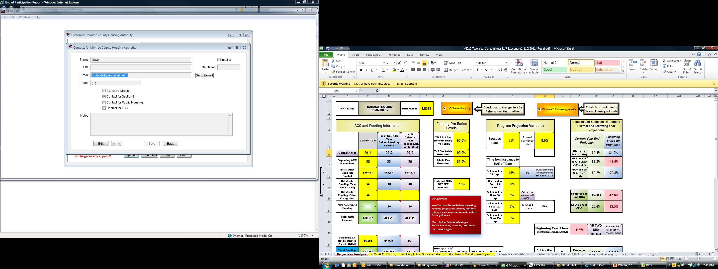
Voucher Forecasting Tool
Input Variables
Input Variables

Slide 78
Voucher Forecasting Tool
Input Variables
Turnover Rate:
- Use PIC EOP Report
-- More conservative
-- Typically < PHA’s actual
- Review and adjust for seasonality.

Slide 79
Voucher Forecasting Tool
Input Variables
Issued Voucher Success Rate
- Conservative % rate is HIGH.
- Based on 12 month period unless
seasonality exists.
- Annualize last 3 months and compare
to 12 month rate.

Slide 80
Voucher Forecasting Tool
Input Variables
Issuance to Lease-up % for 30, 60, 90,
120 days.
- Conservative percentage is HIGH for
30 and 60 days and LOW for 90 and
120 days for the last 12 month period.
- Annualize and review last 3 months
and compare to 12 month % rate.

Slide 81
Simplicity Is The
Ultimate
Sophistication
- Leonardo da Vinci

Slide 82
Thank You !!!

Slide 83
Simplicity Is The
Ultimate
Sophistication
- Leonardo da Vinci

