Slide 1
2021 Small Rural Frozen Rolling Base Overview
Presented By: Eric Hau on September 15, 2021
Author: Eric Hau, Financial Analyst
Milwaukee Field Office

Slide 2
To Frozen Rolling Base or Not to Frozen Rolling Base… That is the Question!!
Which Wisconsin PHAs Were Deemed Small and Rural in 2021 and thus could have Elected to Participate in the Small Rural Frozen Base Program?
Let’s take a look….

Slide 3
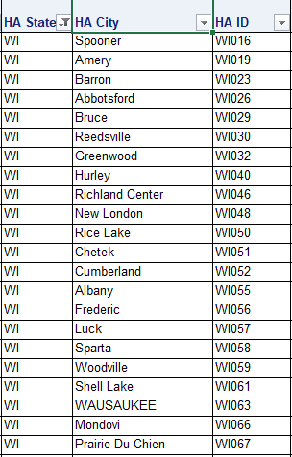
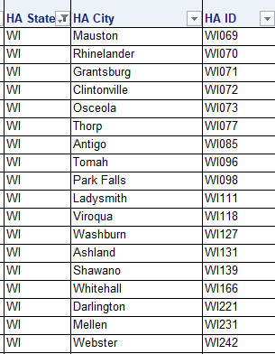
https://www.hud.gov/sites/dfiles/PIH/documents/small_rural_pha_list.xlsx
40 WI LRPH PHAs were deemed “Small Rural” in 2021!!

Slide 4
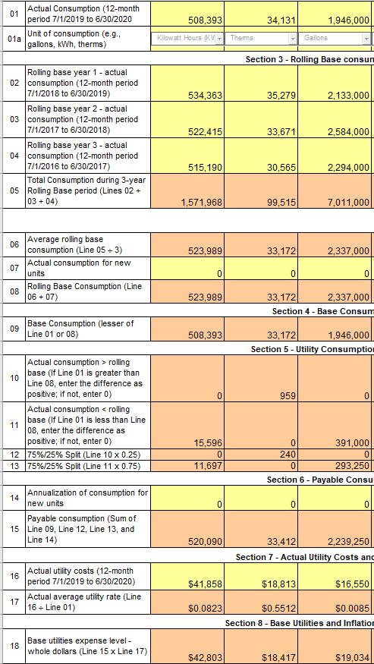
How Do You Save Money In Practice? ←The 52722 Before ….. ←The 52722 Before ….. ←The 52722 Before …..

Slide 5
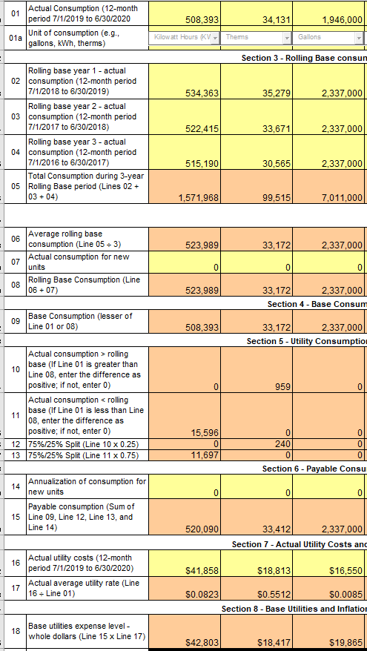
How Do You Save Money In Practice? ←The 52722 After ….. ←The 52722 After ….. ←The 52722 After …..

Slide 6
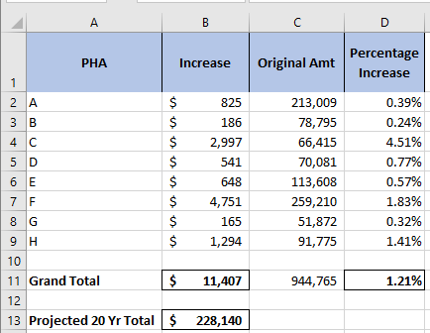
Fortune Favor$ the Bold?

Slide 7
?????QUESTIONS????

