Slide 1
Milwaukee Public Housing: Determining the OpFund Amounts Available For Draws
Presented By: Eric Hau

Slide 2
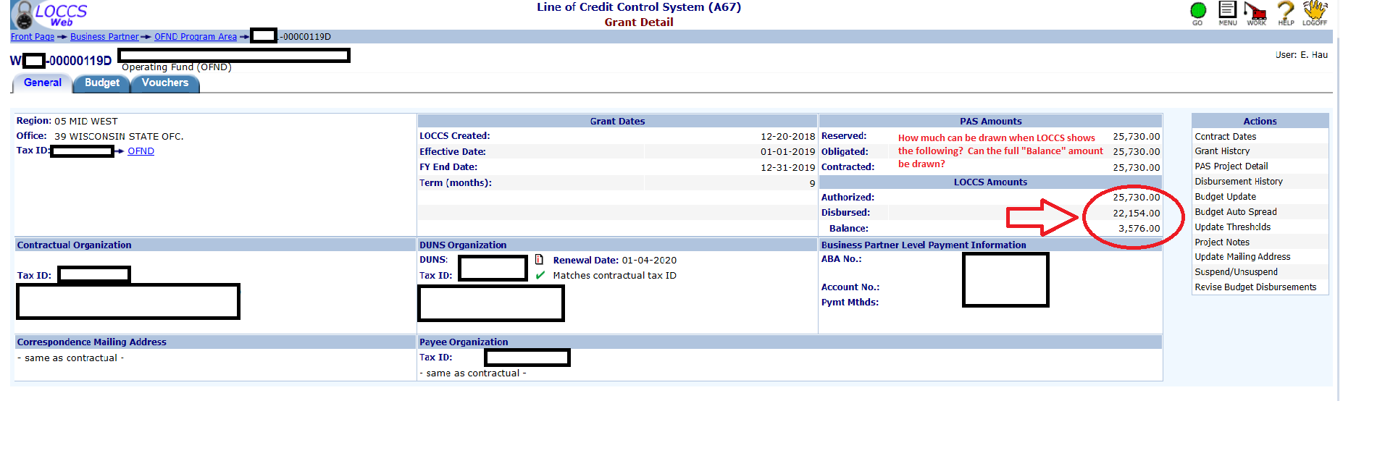
How do we know how much can be drawn in LOCCs?

Slide 3
The answer is……..
It depends……..
Importantly, the amount available for draw in LOCCs depends on 4 factors:
The amount that is “Authorized”
The “Term (months)”
Today’s Date (and specifically the month that we are currently in)
The amount already “Disbursed”
Let’s take a closer look at each of these…..

Slide 4
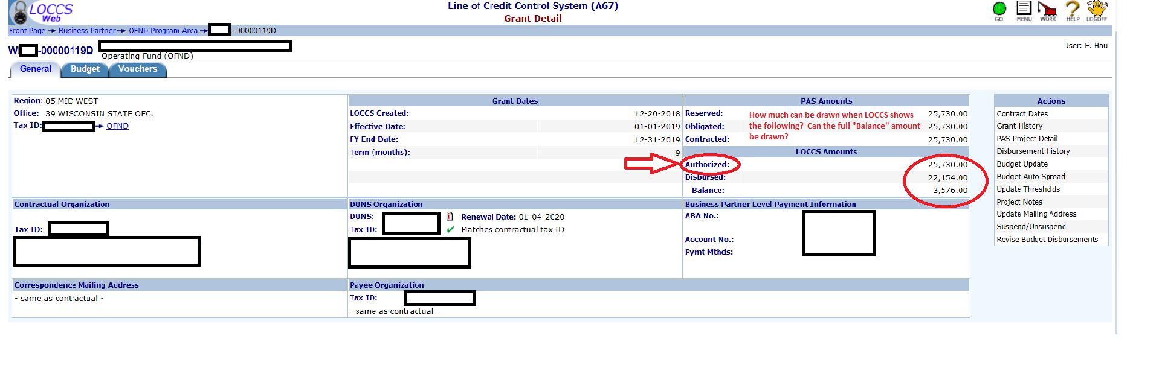
What is the “Authorized” amount?
For a given grant, the Authorized Amount is the total amount of money that Headquarters has made incrementally available in LOCCs to your organization. Please note, this amount is based on your interim eligibility after proration and is adjusted every few months throughout the calendar year. As such, this amount will be lowest in the beginning of the calendar year (because HQ has not made many months of funding available) and will be the highest in December (when all months of funding should be available).

Slide 5
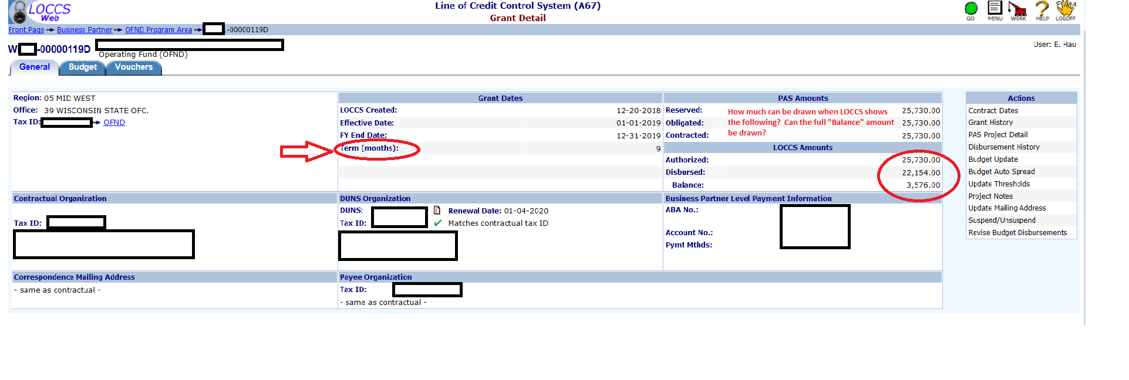
What is the “Term (months)”?
For a given grant, the “Term (months)” is the number of calendar months of funding that the Authorized amount is meant to fund. This number will be lowest in the beginning of the calendar year (because HQ has not made many months of funding available) and will be the highest in December (when all twelve months of funding should be available).

Slide 6
What is today’s date (and specifically what month numerically)?
You may not believe this but……
TODAY’S DATE IS August 16, 2019….
How is that possible?
It’s possible because that is when all the LOCCs screenshots in this presentation are from.
SpOOKy!?
So the numerical month that equates to August is 8 (i.e. 8/16/19)

Slide 7
Finally, what is the “Disbursed” amount?
For a given grant, the “Disbursed” amount is the amount that has already been drawn by the PHA. LOCCs keeps a cumulative tally of the amounts drawn for each grant. As such, this number will steadily increase throughout the year as draws are made.

Slide 8
Ok, ok, enough blabbering. How much can be drawn?
Technically, the entire balance could be drawn, but only if there is a legitimate business reason. However, the LOCCs system is only expecting a draw based on today’s numerical month as compared to the “Term (months)”. Any amount requested above that amount will cause your draw to be reviewed by our office.

Slide 9
Here’s the equation to figure out how much can be drawn without triggering a review by our office:

Slide 10
But where does the Authorized Amount come from? And how is it calculated? And why doesn’t it come close to matching the eligibility amount that was on my 52723?
Each year the OpSub folks publish an OpSub Processing page for that year. Here’s a link to this year’s:
https://www.hud.gov/program_offices/public_indian_housing/programs/ph/am/of/opfnd2019
This is where we will find our answers to all of these questions.

Slide 11
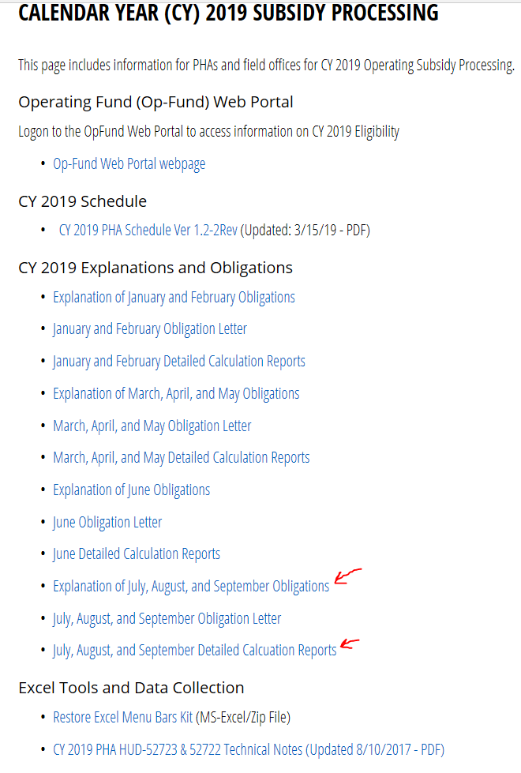
The latest Explanation Letters and Detailed Calculation Reports are key

Slide 12
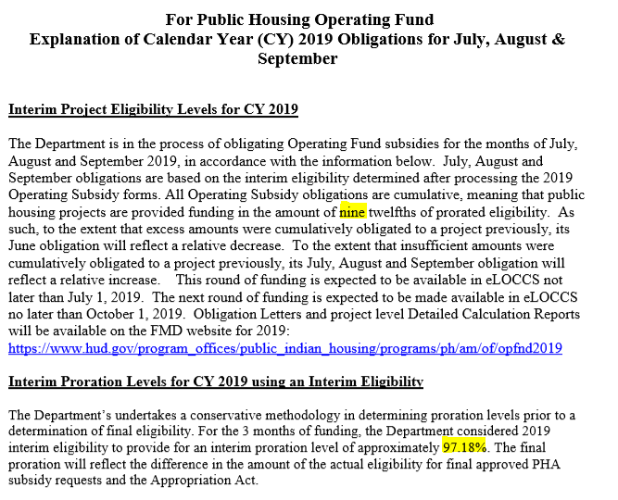
Let’s pull open the Explanation Letter:
https://www.hud.gov/sites/dfiles/PIH/documents/POS8%20ExplanOblgJulAugSep%202019.pdf

Slide 13
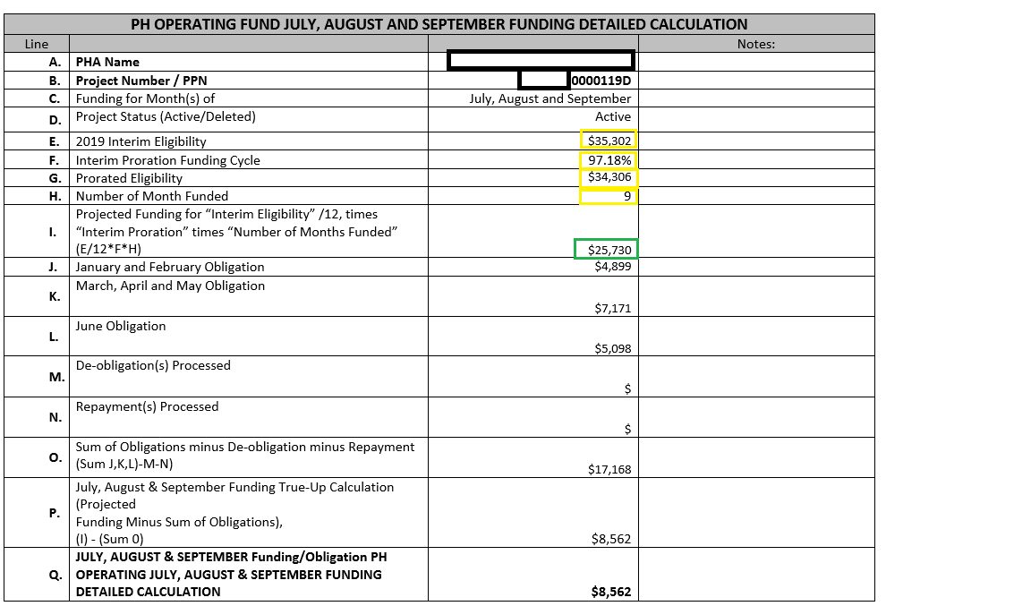
Now let’s pull open our mystery PHA’s detailed Calc Report:
https://www.hud.gov/sites/dfiles/PIH/documents/WI_JulAugSepRpt2019.PDF
This link provides all calc reports for all of WI, but here’s the mystery PHA’s. All answers are here:

Slide 14
?????QUESTIONS????

