Slide 1
U.S. Department of Housing and Urban Development
LOCCS Manual
Larry Wood
April 9, 2014

Slide 2
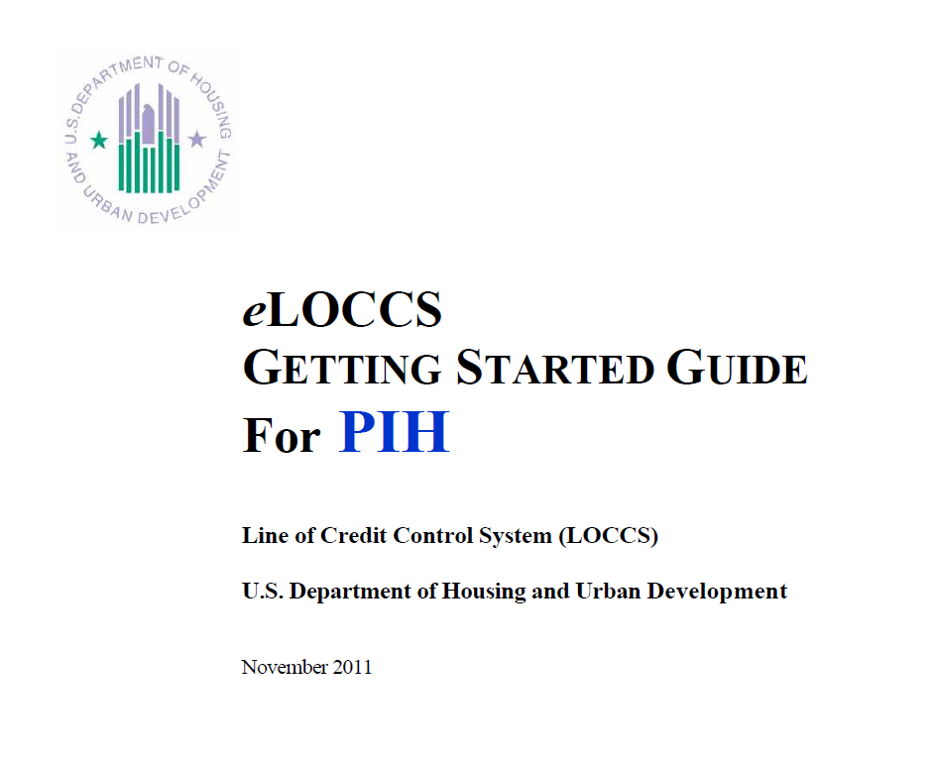
LOCCS Manual – Getting Started
http://portal.hud.gov/hudportal/documents/huddoc?id=eloccsguide.pdf

Slide 3
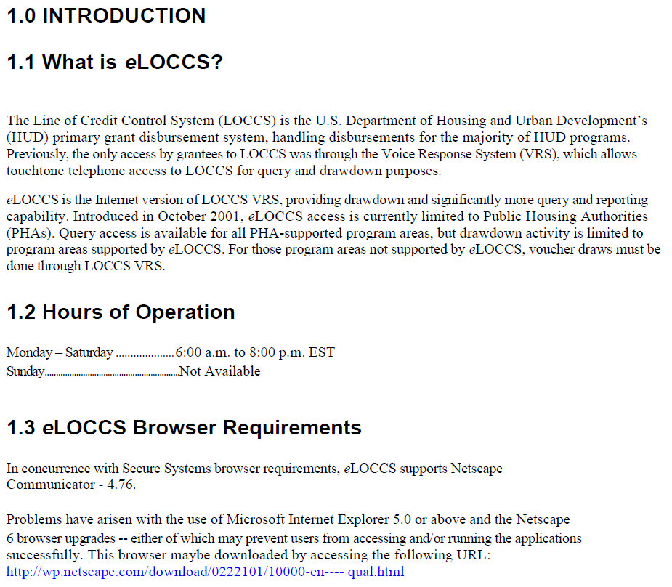

Slide 4
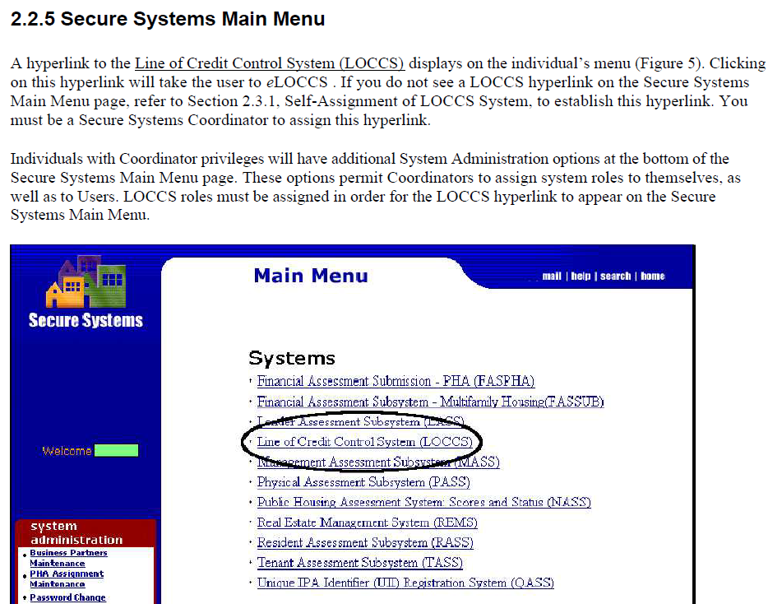

Slide 5
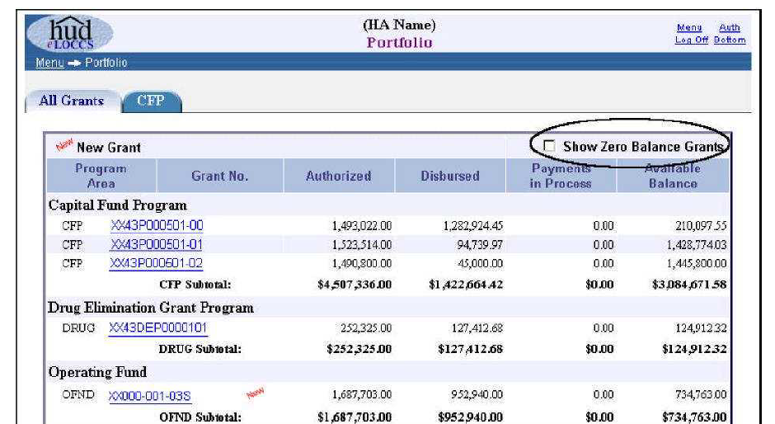
3.1.4.1 Grant Portfolio
The Grant Portfolio Page (Figure 19) lists funding information of All Grants by program area authorized for the User. The page offers a budget snapshot of grant information with balance amounts including any new grants that have been assigned to the Portfolio within the past 30 days. A new icon will be displayed next to the grant for 30 days. Depending upon whether the grant is awaiting the program office to spread the initial budget, the available balance amount may be zero.
Above the column headings on the right is a checkbox indicating Show Zero Balance Grants. To view grants with zero balances mark the checkbox and eLOCCS will automatically load any grants with zero balance amounts on the Grant Portfolio page. To return to the original grant portfolio balance amounts simply deselect the checkbox.

Slide 6
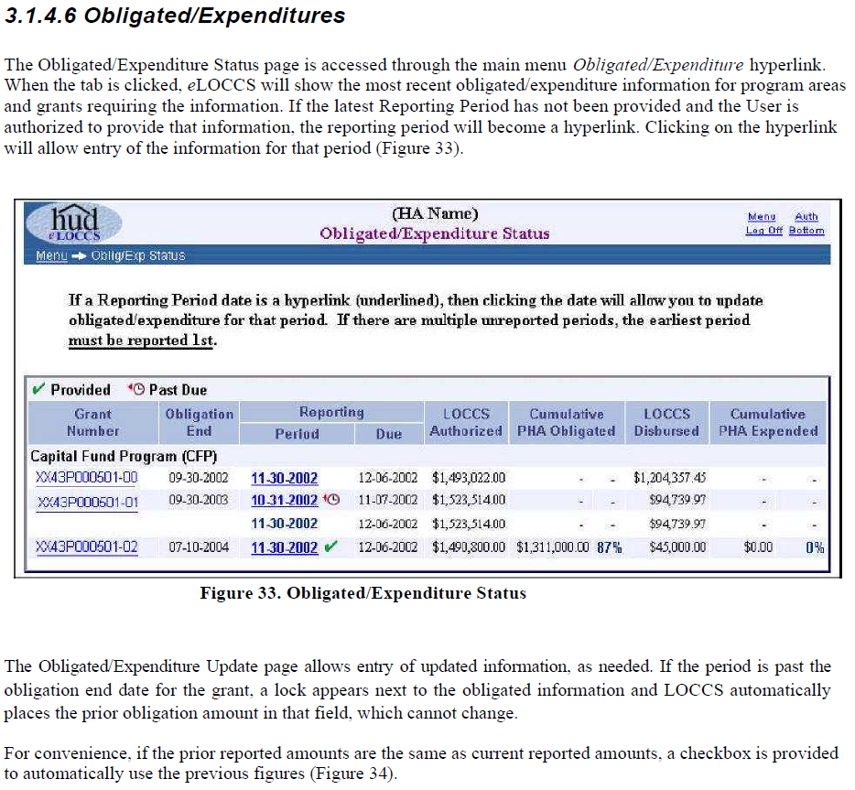

Slide 7
3.1.4.8 Maintain Email Addresses
A useful feature of eLOCCS is the ability to provide emails of LOCCS HUD actions that affect the funding of grants in a portfolio. These emails will alert you when funding for the contract/grant has changed. The Business Partner maintains both the email repository list and the LOCCS email that each email address will receive.
In order to update or maintain email addresses, Users must have the Secure Systems LOCCS role
Administration assigned. See Section 2.3 Secure Systems for LOCCS Assignment/Roles. With this role assigned, the eLOCCS menu options will display Maintain Email Addresses and Maintain Email Assignments hyperlinks on the eLOCCS main menu page.
Clicking Maintain Email Addresses displays an entry page with an upper and lower section (Figure 37). The upper section specifies the primary LOCCS email address for the Business Partner. This email address automatically receives all LOCCS email; no specific email assignment is necessary. For this reason, it is suggested that the primary email address be a generic email mailbox for the organization. This type of mailbox has the benefit of being accessible by multiple individuals. To update your primary email address, click the Update Primary button and enter the email for the organization (Figures 38a)
The bottom portion of the Maintain Email Addresses page (Figure 37) provides an area for adding, deleting and updating any number of additional email addresses for individuals in the organization. (Figures 38b and c) These additional email addresses will not automatically receive any email and must be mapped manually to a type of email through the Email Assignment option from the main menu. See Maintain Email Assignment section 3.1.4.9.

Slide 8
4.1 Troubleshooting/Tips
By far, the most frequent problem encountered by Users is difficulty accessing eLOCCS. This is due to the PHA Coordinator’s improper setup of access in Secure Systems. Once access has been established in eLOCCS through Secure Systems, Users report very few problems with navigating and using eLOCCS. Multiple components and systems support eLOCCS access; therefore, the nature of the particular problem willdetermine the contact person. Listed below are some eLOCCS troubleshooting tips, common problems and resolutions:
1. I’m a Coordinator and I do not see the LOCCS hyperlink on my main menu.
The fact that you are a Coordinator and have assigned the LOCCS system to yourself does not mean you (a Coordinator) have access to LOCCS; it only means you have authority to provide this hyperlink to others. If Coordinators also need direct access to LOCCS, they should completed a HUD 27054 form and forward to your local Field Office for review (who will then forward to the User Support Branch), and assign at least one of the LOCCS roles (Query and/or Administration) to themselves. See Section 2.3.1.2.

Slide 9
2. I’m a Coordinator and I don’t see the LOCCS roles to assign to my Users.
You (a Coordinator) have not assigned the LOCCS system hyperlink to yourself. Without LOCCS hyperlink being assigned, you will not see the LOCCS roles to assign to Users on the Maintain User Information page. See Section 2.3.1.1.
3. I’m a User and I don’t see the LOCCS hyperlink on my Secure Systems Main Menu.
The Coordinator has not assigned LOCCS role(s) Query and/or Administrative to your Secure Systems ID. The association of these roles will place the LOCCS hyperlink on your Secure Systems Main Menu. See Section 2.3.1.2.
4. When I click on a program area in eLOCCS the main menu is blank.
The Coordinator has indeed assigned a LOCCS role to you. This can be assumed because the LOCCS hyperlink appeared on the Secure Systems Main Menu, but they were probably assigned a Section 8 Contract Administrator role, which means nothing to a PHA user.
Have the User verify with the Coordinator that they have been assigned either LOCCS – Query and/or LOCCS – Administration roles. See Section 2.3.1.2.

Slide 10
5. I don’t have any email options displayed on my LOCCS menu.
You were not assigned the LOCCS Administration role by your Coordinator. Have your coordinator add the role to your ID. See Section 2.3.1.2.
6. I don’t see a particular program area on the Authorization page, but it shows up on the Grant Portfolio page of the eLOCCS main menu.
This means you are authorized for query access only for that program area. To have drawdown capability, add the program area to your HUD 27054 form and forward to your local Field Office for review (whowill then forward to the User Support Branch). The program will then appear on your eLOCCS Authorization page after the approval process.

Slide 11
7. When I click on the LOCCS hyperlink from the Secure Systems main menu, I am sometimes prompted to enter my ‘User Name and Password’ even though I previously entered my Reac User Name and Password.
The fact that you have been prompted twice to enter you Reac Log In information indicates you are using the Internet Explorer (IE) browser, which has a double authentication process. Only when the message box prompts you to enter your “LOCCS HUD-27054 User ID and Password” do you enter your numeric LOCCS (VRS) User ID and Password. See Figure 15.
8. My PHA/Organization address is incorrect in eLOCCS.
To change your organization address, send in a revised SF-1199A to your program office (who will then forward to FtWorth Accounting). The reason is that LOCCS is a payment system, where a payment could be made by check. Therefore the name and address of the organization is treated as if it were banking/payment information, requiring a SF-1199A.

Slide 12
9. When I attempt to do a drawdown from the Payment Voucher Entry hyperlink, I get a grant information page with budget related tabs.
You have either selected a grant from the Grant portfolio hyperlink or in fact selected the Payment Voucher Entry hyperlink off the main menu, but clicked on the grant, which displays general grant information. The only way a drawdown can be completed is through accessing the Payment Voucher Entry hyperlink through the main menu. Once this has been selected, mark the check box next to the desired grant and click the submit button at the bottom of the page to continue the drawdown process.
10. Can I change my password in eLOCCS prior to the 60 day prompt?
Yes. After a program area has been selected from the authorization page, the Change Password option will be on the left sidebar of any program area menu, directly under your User Profile option.
11. How can I find out which browser version I am using?
Open your browser and click on the Help dropdown bar located on the top portion of the browser tool bar page. From the list select the last option, which begins with about.... (browser name). This option will indicate your browser version.

Slide 13
