Slide 1
2014 Wisconsin Landlord Tenant Law Update
Judy Tucker Associate Regional Counsel Milwaukee HUD Office
Judy.Tucker @hud.gov

Slide 2
Sources of state landlord - tenant law
Statutes – mostly in Wisconsin Statutes Chapter 704, but also in various other part of the state code
Administrative rules – Wisconsin Department of Agriculture, Trade and Consumer Protection, Chapter ATCP 134, Wis. Adm. Code (But rules must now be in line with Chapter 704.)

Slide 3
Sources of state landlord - tenant law
Case law – important opinions in state courts such as Williams vs. Housing Authority of City of Milwaukee (uncorroborated hearsay evidence alone does not constitute substantial evidence to support an administrative hearing decision)
Opinions of Wisconsin Attorney General
Procedural rules of local courts
Local ordinances – if permitted by state statutes

Slide 5
State vs. federal requirements
Actual direct conflicts between state and federal rules are rare
Occupancy Guidebook and lease/tenancy addenda/HAP contract are good starting place for summary of HUD requirements and often refer to relationship with state law
In general, for rules that deal with tenant rights or protections, the most protective rule (state or federal) will apply.

Slide 6
State vs. federal cont.
If you read the actual HUD statute or regulation, very often it will indicate how its requirements interact with state/local law.
Changes to Wisconsin landlord-tenant laws in recent years have made understanding the interplay of state and federal laws more challenging.

Slide 7
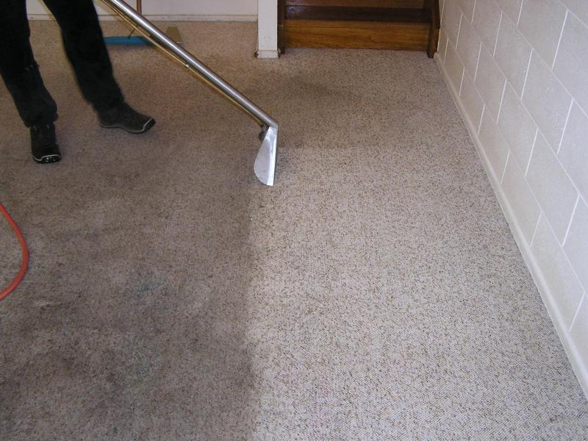
Carpet cleaning…
… a legal quandary?

Slide 8
July 2013 Wisconsin Attorney General Opinion regarding carpet cleaning
Some residential leases contain requirement that the tenant pays for professional carpet cleaning at end of tenancy.
Raises question of whether such carpet cleaning is part of landlord’s statutory duty to keep premises in a reasonable state of repair.
Statute and administrative rule prohibit landlord from shifting landlord’s obligations onto tenant.

Slide 9
OAG-04-13 cont.
DATCP had taken the position that carpet cleaning lease provisions are illegal.
AG concluded that routine carpet cleaning is not a “repair” and thus is not a legal duty of the landlord.
Thus carpet cleaning responsibility can be decided by contract (i.e. lease).
Doesn’t mean that carpet cleaning costs can be withheld from security deposit! (See 704.28 and your attorney.)

Slide 10
Carpet cleaning in Section 8 leases
24 CFR 982.308: landlords must use their standard lease form if they have one and it might include this provision
PHA can review lease for compliance with state and local law- If a HCV landlord had carpet cleaning as a tenant requirement in the lease, this provision would now comply with state law.

Slide 11
Carpet cleaning in Public Housing lease
Consult your attorney!

Slide 12
OAG opinion citation
http://www.doj.state.wi.us/sites/default/files/oag-04-13_0.pdf

Slide 13
2013 revisions to landlord tenant law
2013 Senate Bill 179
Most provisions effective March 1, 2014
Generally favorable to landlords

Slide 14
Limits on local ordinances
Prohibits local ordinances that limit a residential tenant’s responsibility, or a landlord’s right to recover, for any damage or waste to, or neglect of the premises.
Prohibits local ordinances that require a landlord to communicate any information to tenant or to local government not required by state or federal law (except contact info).
Eliminates about 25 local laws in Madison.

Slide 15
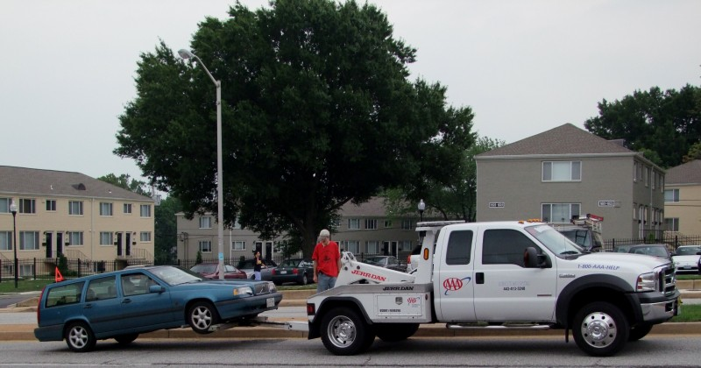

Slide 16
Eases towing of vehicles
349.13 (3m): If property is properly posted, then vehicle can be towed at vehicle owner’s expense without a citation. Vehicle must be removed by a towing service. Request can be made by property owner, owner’s agent, traffic officer or parking enforcer. Towing service must give description of car to local law enforcement.
Goes into effect July 1. (WIDOT to issue guidance on posting etc.)
Does not apply if car has been reported as stolen.

Slide 17
Tenant property upon eviction
Under old law, if a tenant leaves property of value on the rental premises after being evicted, the property must be removed and stored. The evicted tenant is notified of the location of the property and provided with the receipt needed to obtain possession of the property. The evicted tenant is responsible for the costs of storage. In Milwaukee County, the sheriff must remove and store the property. In all other counties, the landlord may choose to be responsible for the removal and storage of the property. If the landlord does not choose to remove and store the property, the sheriff must do so.
Under revised 704.05 (5), if a tenant is evicted or moves and leaves behind property and the lease or renewal contains notice that the landlord will not store the tenant’s property, then the landlord may discard property, other than prescription medicine or medical equipment, in any manner that the landlord determines is appropriate. Notice doesn’t have to be in every renewal. (1x is OK)

Slide 18
Public housing and HCV leases
May add this nonstandard rental provision
No HUD issues raised other than procedural issues on modifying the lease
Keep in mind the special rules for medical items (hold for 7 days) and titled vehicles (provide notice to tenant and lien holder)

Slide 19
Security deposit return after eviction
Under old law, if a tenant is evicted, a landlord must return the security deposit to the tenant, less any amounts that are appropriately withheld, within 21 days after the date on which the writ of restitution is executed or the date on which the landlord learns that the tenant has vacated the premises, whichever occurs first.
New 704.28(4) provides that the timing of the return of the security deposit depends on whether the tenant is evicted before or after the termination date of the lease. If the tenant is evicted before that date, the landlord must return the security deposit within 21 days after the lease terminates or, if the landlord re-rents the premises before that day, the date on which the new tenant’s tenancy begins. If the tenant is evicted after the termination date, the landlord must return the security deposit within 21 days after the date on which the landlord learns that the tenant has vacated the premises or the date the tenant is removed by eviction.

Slide 20
Security Deposit cont.
How often do evicted tenants get their security deposit back?

Slide 21
Speeds up eviction proceedings
All residential eviction trials on the first cause of action (i.e. return of the premises) must be held and completed within 30 days of the return date/initial appearance. This new law applies to both bench and jury trials. See Tristan’s landlord Tenant Law Blog http://petriestocking.com/blog/tag/sb-179/
So even if tenant requests jury trial, it must occur within 30 days.

Slide 22
Service of process in evictions
Some less urban counties may adopt a local rule permitting service by mail.
New 799.05(3)(b), Wis. Stats. states that the return date (initial appearance) in court can be no less than 5 days and no more than 25 days after service is issued (i.e. the tenant is served with the eviction summons). Old law required the return date be held no less than 5 days and no more than 30 days after service.
It will be important that landlords make sure that their process servers are aware of this law change starting March 1, 2014 otherwise it could result in their evictions being dismissed if the return date/initial appearance is scheduled more than 25 days after service is effectuated.

Slide 23
Other changes in eviction process
Loosening of rules of who may appear in small claims actions in court. May see more management agents, landlords representing themselves.

Slide 25
“Crime-free” lease provisions
704.44 (10)- A lease that allows the landlord to terminate a tenancy for a crime committed in relation to the rental property is void if a required Notice of Domestic Abuse Protections (704.14) is not an addendum to the lease.
2011 provision that arguably made most leases that complied with HUD rules on crime unenforceable has been clarified. Now clearer that leases may not permit terminations for crime if the tenant is the victim.

Slide 26
Notice of Domestic Abuse Protections
704.14 requires a specific notice of the state domestic violence protections to be an addendum or included in every residential lease.
Federal VAWA does not apply to all tenants. Doesn’t apply to market rate tenants or tenants of old 202 direct loans with no Section 8, etc.
Wisconsin state law domestic abuse protections do not mirror federal law exactly.
HUD will permit required notice as an addendum with note that it is required by state law. Otherwise, HUD “one-strike” provisions could be argued to be unenforceable.

Slide 27
Bedbugs

Slide 28
Bedbug/pest remediation
704.07(3)(a): if unit damaged due to acts or inaction of tenant – including by pest infestation- landlord may choose whether tenant or landlord will remediate
If landlord remediates, “the tenant must reimburse the landlord for the reasonable cost thereof” and the landlord’s cost is presumed reasonable unless tenant proves otherwise.

Slide 29
HUD Bedbug Guidance
PIH Notice 2012-17: A PHA may not charge a tenant to cover the cost of bedbug treatment; such costs should be covered by the PHA. “This notice applies to PHAs administering the public housing and project based Section 8 program.”
Housing Notice 2012-20:Assisted project owners’ requests for tenants to pay the costs of infestation treatment must be in accordance with the provision for tenant payment of damages or noncompliance as required in the Family Model Lease. (Multifamily Housing rule)
Both Notices expect the O/A or PHA (not tenant) to conduct remediation.

Slide 30
Landlord liability for tenant reference
New 895.489
Landlord giving reference to new landlord presumed to be acting in good faith unless shown by clear and convincing evidence that landlord knowingly provided false information or made the reference maliciously.
Landlord immune from civil liability resulting from providing reference.

Slide 31
Landlord acceptance of rent during pending eviction
799.40(1m)
Eviction action may not be dismissed because landlord accepts overdue rent or any other payment from tenant after the starting eviction proceedings

Slide 33
Disclaimer
HUD can’t give legal advice on state law to owners or PHAs.
Can provide limited assistance in understanding the interplay between state law and HUD requirements.
This presentation is not a substitute for legal advice from an attorney that knows the facts and circumstances of the PHA’s matter.

