Slide 1
Expanded Flexibilities for RAD:
Key Changes in the Revised RAD Notice
July 16, 2013

Slide 2
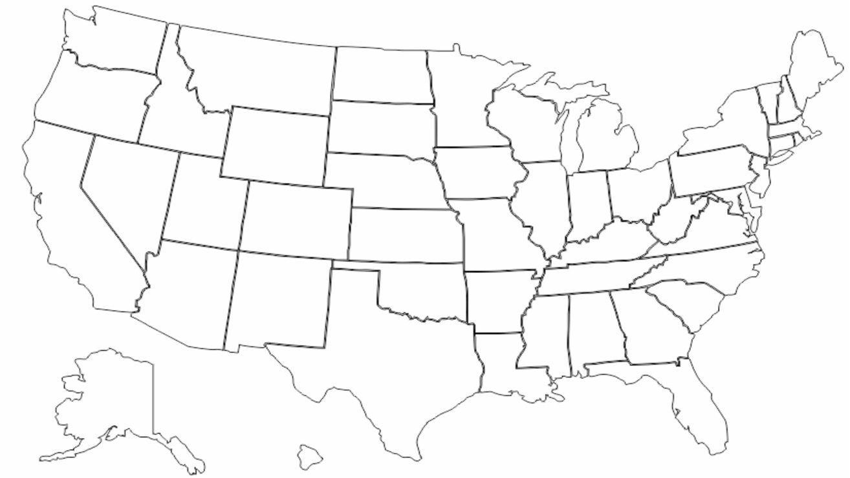
RAD Across the Country – 1st Component
 | Northeast | Midwest | South | West | Total
PHAs and Mod Rehab Units Awarded | 949 | 1,279 | 9,997 | 2,556 | 14,781
949
Units
1,279
Units
2,556
Units
9,997
Units

Slide 3
RAD Across The Country
1st Component
132 CHAP awards, representing 14,781 units
51% conversion to PBRA, 49% conversion to PBV
Over 60% of proposals planning to use LIHTCs (the vast majority being 4% credits)
Over 60 partnering lenders and investors
Expected to raise $816M in debt and equity instruments
2nd Component
Approved 5,000 units in 48 projects
Expecting additional 2,000 unit approvals by end FY 2013
Over 120 projects awaiting approval with additional authority

Slide 4
Key Changes in the RAD Notice
Locks in 2012 contract rents for all applications received by 12/31/13 (applies to individual applications, portfolio awards, and multi-phase awards)
  Operating Fund (with Operating Fund Allocation Adjustment restored)
  + Capital Fund
  + Tenant Rents
  = RAD Contract Rent
Allows a PHA to “bundle” rents to facilitate financing as aggregate subsidy does not exceed current funding
Future Replacement Housing Factor (RHF) funds can be collateralized into RAD rent
MTW agencies may use existing voucher funds to set initial contract rent
  Not to exceed market rent
  Subject to Subsidy Layering Review
  Subject to MTW continued service requirements

Slide 5
Key Changes in the RAD Notice
Eliminates caps on units that can convert for:
  Public housing
  Mode Rehab
Creates new awards for:
  Portfolio conversions
    PHA defines “portfolio” of projects, either the entire PHA inventory or some subset
    PHA must submit applications for at least half of the projects in portfolio
    HUD will reserve award for remaining units in portfolio
    PHA must submit application for remaining projects in portfolio within 365 days
  Multi-phase conversion
    Allows PHAs to reserve conversion authority for projects with multiple development phases with applicable contract rent for all phases
    PHA has until July 1, 2015 to submit application for final phase
    PHA required to fulfill all CHAP milestones for each CHAP awarded
    Upon application acceptance, HUD will issue CHAP for initial phase and multi-phase award letter covering all phases of project
  Joint RAD/CNI applicants
Opens the Ongoing Mod Rehab Application Period

Slide 6
Key Changes in the RAD Notice
Mixed Finance projects
  Removes unit cap for Mixed Finance projects
  Allows financially distressed HOPE VI projects to apply
Exempts awarded projects from the Public Housing Assessment System (PHAS)
Extends Capital Fund obligation and expenditure deadlines
Clarifies conditions for “rehab assistance payments”

Slide 7
RAD Awards Trend Chart

Slide 8
Lenders and Tax Credit Investors
Alliant Capital
Boston Capital
California Community Reinvestment Corporation
Centerline Capital Group
Community Affordable Housing Equity Corporation
Community House Partners Development Corporation
Direct Tax Credits, Inc.
Enterprise Community Investment
Georgia Department of Community Affairs
Great Lakes Capital Fund
Hudson Housing Capital
Hunt Capital Parnters
National Equity Fund
Newport Partners LLC
Ohio Capital Corporation
Ohio Capital Housing Corporation
PNC Real Estate
Prestige Affordable Housing Equity Partners
Raymond James Tax Credit Funds Inc.
RBC Capital Markets
Bellwether Enterprise Real Estate Capital LLC
Capital Fund Services Inc.
Crain Mortgage Group LLC
Fifth Third Bank
First Citizens Bank NA
Forest City Capital Corporation
Great Lakes Capital Fund
Highland Commercial Mortgage
Lake Forest Bank & Trust Company
Lancaster Pollard
Love Funding
M&T
PNC Real Estate
Prudential Huntoon Paige Associates LLC
RBC Capital Markets Housing Finance Group
Red Mortgage Capital
Rockport Mortgage
St. James Capital LLC
US Bank Community Development Corporation
Walker Dunlop
Arbor Commercial Mortgage
Beekman Securities
Centerline Mortgage Capital
Chase Bank
Columbus Bank and Trust
Continental Mortgage Corporation
Federal Home Loan Bank of Chicago
Hunt Capital Partners
McCan Communities
New Mexico Bank & Trust
NW Financial Group LLC
Rabobank N.A.
Red Stone Equity Partners
SunTrust Bank
TD Bank US Bank
Red Stone Equity Partners
Richmon Group
Union Bank

Slide 9
RAD Web Page
RAD Notice, application materials, and additional resources can be found at
www.hud.gov/rad
Email questions to rad@hud.gov

