Slide 1
RAD Workshop

Slide 2
RAD Workshop
What is RAD? HUD demonstration program that combines public housing operating and capital subsidy into a Section 8 HAP contract
What kinds of developments are being done with RAD? Minor rehab; major rehab; new construction; mixed income; off-site replacement housing
How do I determine if I have a project/portfolio that would be a good candidate for RAD conversion? Use the RAD Inventory Assessment Tool in the Resources section of www.hud.gov/rad
How would RAD affect:
Residents: No change; 30% of income for rent
PHA Functions: Dependent on cash flow, fees, strong management; puts them on the more secure Section 8 funding platform; Gives them the affordable housing tools of other nonprofit developers
Resources: www.hud.gov/rad; www.radcapitalmarketplace.com; www.radresource.net

Slide 3
This is rad
At closing, funding is converted to a Section 8 contract rent
ACC
Section 8

Slide 4
PUBLIC HOUSING CONVERSIONS
Key Provisions
Public Housing & Mod Rehab
Convert at current funding only
PBRA or PBV
Cap of 60,000 units
Choice-Mobility, with limited exemptions
Extensive waiver authority to facilitate conversion
First come, first served after close of initial competitive window (10/25/2012)
All applications must be received by 9/30/2015

Slide 5
PUBLIC HOUSING CONVERSIONS
RAD Contracts & Post-Conversion Terms
Option of PBRA or PBV contracts
Long-term renewable use & affordability restrictions
Secretary shall offer & the owner shall accept renewal of the contract
Public or non-profit ownership or control, except after foreclosure, etc., or to facilitate tax credits
Transfer of assistance to replacement units
Public Housing Section 18 Demo/Dispo application not needed for conversion of substantially all units
Requirements for assistance established through contracts, use agreements, regulations, etc
Waiver authority for PBV, PBRA, Operating Fund, Capital Fund
Evaluation

Slide 6
PUBLIC HOUSING CONVERSIONS
Resident Provisions
No Re-Screening of Residents at Conversion
One-for-One Replacement Must convert all or substantially all units in covered project
Family Self Sufficiency Current FSS participants continue in program
Resident Participation & Funding PHA must recognize legitimate tenant organizations PHA must provide $25 per occupied unit annually for resident participation ($15 per occupied unit > legitimate tenant organization
Resident Procedural Rights Consistent with Section 6 of the 1937 Housing Act
Resident Relocation Consistent with Uniform Relocation Act

Slide 7
results of the competitive round
Initial Public Housing Awards
Total applications: 113
Total awarded public housing projects: 110
Total awarded PHAs: 68
Total awarded Public Housing Units: 11,910
PHA Size*
32% Small (<250 Units in Inventory)
52% Medium (251-1,249 Units in Inventory)
16% Large (1,250+ Units in Inventory)
*Based on 68 awarded PHAs

Slide 8
Results of the competitive round
Geographic Distribution:
Received applications in all four geographic areas and all sizes of PHAs in those areas
Largest # of awards in the South: 63 awards for 7,645 Units
Capital Needs
22% New Construction
78% Rehab
24% proposed Greater than $50k in Rehab
23% proposed $30K to $50K in Rehab
21% proposed $10K to $30K in Rehab
32% proposed Less than $10K in Rehab

Slide 9
Results of the competitive round
Type of Section 8 subsidy (by project)
54% Project Based Vouchers (PBV)
46% Project Based Rental Assistance (PBRA)
Type of Section 8 subsidy (by Unit)
44% Project Based Vouchers (PBV)
56% Project Based Rental Assistance (PBRA)

Slide 10
Financing resources
$977 Million in Total Financing Sources
$74 million PHA supplied (Operating; Replacement Housing Factor Funds, Cap Funds, etc.)
$257 million 1st Mortgage
$409 million in 4% and 9% LIHTC
$237 million in second mortgages and soft financing: HOME, CDBG, AHP, etc.

Slide 11
nonprofit Developer objectives
Partner with PHAs to:
Modernize aging family & elderly properties
Substantial rehab of deteriorated properties
Demolish/replace severely distressed/obsolete properties
Thin densities/mix incomes via RAD HAPs and transfer authority
Place RAD HAP contracts in off-site units in high amenity locations
Increase QAP scoring by serving more VLI families
New 20 year HAP contract funding

Slide 12
CHOOSING THE TYPE OF SECTION 8
PBRA
Provided to owners by HUD’s Office of Housing via a HAP (Part of HUD Multifamily)
Projects monitored by PBCA’s
No administrative fee to PHAs
20 years
Subject to annual appropriations, but strong history of full appropriations
PBV
Component of PHA’s Housing Choice Voucher Program in which the PHA attaches a voucher to specific units via a HAP (Part of HUD Public Housing)
Voucher funding administered by PHA
PHA can earn administrative fee
15 years (up to 20 with approval of voucher agency)
Subject to annual appropriations but with a history of appropriation reductions

Slide 13
CHOOSING THE TYPE OF SECTION 8
PBRA
PBV
20 year RAD Use Agreement
Choice mobility option can be limited to 15% of the RAD project units and/or 33% of the PHA’s annual HCV turn-over
Contract rent setting: Lower of current funding and 120% FMR minus utilities (higher with RCS)
No direct Board approval requirement on-going
No HUD social services requirement
20 year RAD Use Agreement
Choice mobility option unlimited: if annual HCV turn-over is insufficient to meet CM, departing RAD residents go to top of HCV’s waiting list.
Contract rent setting: Lower of current funding; reasonable rent; 110% FMR minus utilities
Annual Board budget approval
If PBV>50% social services mandatory in family projects
Waiver of provisions regarding deconcentration of poverty

Slide 14
Quantifying Rehabilitation Needs
For RAD application, use best available information on rehab needs, 5 year PNA, etc.
Within 60 days of Commitment to enter into a Housing Assistance Payments Contract (“CHAP”), contract with a qualified Physical Conditions Assessment (“PCA”) contractor and file the completed PCA with HUD.
PCA components:
Compares traditional and green rehab; (Forensic research for buildings > 30 yrs. Old
Energy audit
Integrated Pest Management (IPM) Inspection
RPCA guidance on Hud.gov/rad
Not required for demolition and new construction

Slide 15
RELOCATION CONSIDERATIONS
Unlike Section 18 demo/dispo, no additional new Section 8 vouchers are available with RAD
Must be done in compliance with URA
RAD HAP contract funds at construction closing
Residents cannot be involuntarily permanently dislocated
The cost of temporary relocation
factored into the development budget
Partially offset by funding of Section 8 rents during construction

Slide 16
Threshold issues
Capital Fund Financing program (CFFP)
Can be pre-paid, depending on loan terms
HUD will waive the 5% change restriction (but lenders can enforce)
EPC
Typically smaller amounts
Shorter loan terms
Can be subordinated

Slide 17
Public Housing Resources & Tools
Determining a PHA’s RAD Rent
www.hud.gov/rad
“Resources”
PHA Conversion Guide
RAD Inventory Assessment Tool
Fill in PHA #
Populate
Fill in basic financing assumptions
Top rent in BOLD is RAD rent
Feasibility with debt only
Feasibility with 4% LIHTC & 9% LIHTC

Slide 18
Public Housing Resources & Tools
RAD Inventory Assessment Tool for PHAs

Slide 19
RAD Financing
Debt
Conventional
Soft secondary
Credit enhancement
FHA Insurance
FHA Mortgagee Letter for RAD transactions
LIHTC Pilot
LIHTCs
4% availability & considerations
9% availability & considerations

Slide 20
FHA Multifamily Mortgage Insurance
Section 223(f)
Refinance or acquisition
Minor/moderate repairs ($6,500/unit*high cost factor)
Permanent debt with repair escrow - up to 35 years
Section 221(d)(4)
Substantial rehab: 2 major building systems
Construction/permanent debt all in one - initial/final closing
40-year financing
Mortgagee Letter for RAD Transactions issued 10/12
Eligibility, underwriting criteria, processing & materials

Slide 21
FHA LIHTC Pilot Program
Streamlined-Enhanced FHA 223(f) & LIHTCs
Rehab expenditures of up to $40,000/unit
Tax credit or Bond Cap allocation in hand
Processed in Multifamily Hubs
Using MAP lenders approved for the Pilot
Goal of 3-4 month turnaround on applications

Slide 22
RAD & LIHTCs
RAD Sweet Spot—Debt Only
Abt study—$24k/unit average capital need
Opex at $4,500 pupy + $300 replacement reserves
FHA debt at 3.45%; 1.2 DCR
Feasible with RAD rents above ~$610/month

Slide 23
RAD & LIHTCs
RAD Sweet Spot—4% LIHTCs
Rehab needs above $24k/unit to ~$40k/unit
Ease of meeting 50% test with RAD rents
Available P-A Volume Cap
Non-competitive
QAPs favoring preservation, green
Evolving, accessible short-bond structure
Historically low borrowing rates

Slide 24
RAD & LIHTCs
Short Bond Structure for 4% LIHTCs
At Closing
TE bonds with 24 month term issued (1.25%)
FHA 221(d)(4) or 223(f) closes
During Construction
Construction draws: Standard GNMA certificates
Bonds paid down & paid off at construction completion
Reduces negative arbitrage costs
Long Term
Project benefits from 40-year loan at FHA rate of 3.45%

Slide 25
RAD & LIHTCs
RAD Sweet Spot—9% LIHTCs
Targeted prospects for substantial rehab & replacement housing
No Section 18 review
Income mixing
Split project (AMP)
9% LIHTC used to help cover relo/demo/first phase
4% LIHTC for balance of site
RAD HAP contract(s) for off-site replacement
Acquisition/rehab
New construction

Slide 26
RAD & LIHTCs
New Approach to Mixed-Finance
Same LIHTC ownership structures
Thorough PCA
Standard Mixed Finance
Section 18 Demo/Dispo process
1-1 replacement goal, but not required
Screen for re-entry
Often large gap financing requirements
RAD & LIHTCs
No Section 18 Demo/Dispo, but no relocation HCVs
1-1 replacement with de minimus changes,
Right to return, no re-screening
Choice Mobility
Less gap financing needed with RAD rent structure

Slide 27
Considerations for operations
Managing Operating Expenses
Lower, post-rehab
Will have separate replacement reserves per project
Compare to other local, nonprofit operated affordable housing
Powerful impact on the ability to leverage
Compare RAD rents to revised opex: If opex are 60% or less of rents, significantly increases feasibility
Retaining real estate tax PILOT arrangements
Section 8 rent includes utilities; incentives to PHAs to reduce utilities by incorporating green measures

Slide 28
Comparison of PHA fees ACC vs RAD
Assume a 100 unit project, new const, $120K/unit
Per unit per month | Current ACC | RAD
Property Mgmt Fee | $ 45.00 | $ 45.00
Bookkeeping | $ 7.50 | $ 7.50
IT | $ 2.00 | $ -
Asset Mgmt Fee | $ 10.00 | $ -
Capital Fund Fee | $ 15.00 | $ -
Cash Flow |  | $ 20.00
Monthly | $ 79.50 | $ 72.50
Annual | $ 95,400.00 | $ 87,000.00
Annual difference |  | $ (8,400.00)
15 year difference |  | $ (126,000.00)
Developer Fee (15% of $12M) |  | $ 1,800,000.00
Payment on PHA financing ($10k annually) |  | $ 150,000.00
 |  | $ 1,950,000.00
Net unrestricted funds to the PHA over 15 years |  | $ 1,824,000.00

Slide 29
Internal considerations
Each development stands on its own
PHAs have the tools of other affordable housing developers
Property Managers can be empowered to manage their own operating budgets with their own replacement reserves
Significantly more private leverage
Properly structured projects generate unrestricted cash from cash flow, developer fees and loan payments
Funding is more predictable
RAD units:
Require no Annual Plan
Are not in PIC
Staff follow one set of requirements – either PBV or PBRA
Site based waiting lists

Slide 30
The application
Simple, start with basic pro forma www.hud.gov/rad
Application
Two resident meetings
Board meeting and approval
Financing letters
Lender
Investor
If 9% credit, letter from HFA or self-scoring
Choice Mobility: Letter for PBRA; ability to administer for PBV
If converting a project that is currently mixed-finance, need signatures of all parties
Fix “Fatal Error” issues
CHAP Award

Slide 31
Closing process
Post CHAP
DAY 1: CHAP Issued; Transaction Manager assigned
DAY 30: Information on Development Team
(“One Round” allowance for LIHTC; schedule subject to oversight by TM)
DAY 60: Firm Financing Letters
DAY 180: Submit Financing Plan
DAY 360: Closing and Conversion; Section 8 begins to fund
Post Conversion
Temporary Relocation (if necessary)
Demolition (as necessary; no Section 18 approval required)
Rehabilitation or New Construction
Re-occupancy

Slide 32
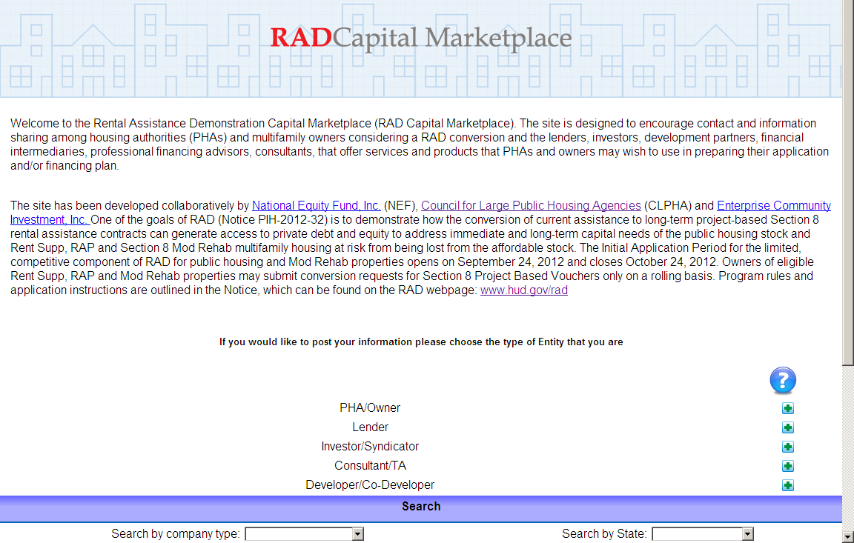
RAD Capital Marketplace
www.radcapitalmarketplace.com

Slide 33
RAD Web Page
RAD Notice, application materials, and additional resources can be found at
www.hud.gov/rad
Email questions to radresource.net

